Slide 1
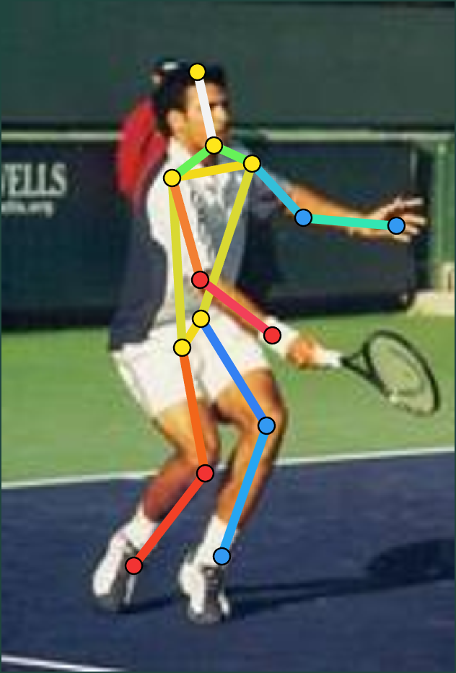
CLASSICAL HUMAN POSE ESTIMATION
FINAL REVIEW • 2026
REVISITING
Quality-gated restoration, flip test-time augmentation and pose voting around an unchanged Flexible Mixtures-of-Parts model
Group 1 · G O Ashwin Praveen · Atharva Unnikrishnan Nair · Karthik Kishor · Revathi V
B.Tech Computer Science & Engineering
FROM PIXELS → FEATURES → BODY STRUCTURE
Notes:
Final review of our Group 1 project. At mid-review we had an adaptive preprocessing layer that barely changed the results. Since then we rebuilt it: proper noise and blur handling, flip test-time augmentation, pose voting and refinement, and evaluated everything on held-out images. The FMP model itself is still the original 2011 model, unchanged. The skeleton on the right is our system’s real output on a held-out PARSE test image.

Slide 2
The challenge is not just finding a person
01 / WHY
LIGHTING & CONTRAST
POSE VARIATION
BASELINE FMP · PCK %
Dark regions and weak edges can hide useful patterns.
Arms and legs appear in many configurations.
75.4
Clean
Dark
75.5
Low contrast
74.8
NOISE & BLUR
SCALE VARIATION
Random gradients and soft edges corrupt HOG features.
The same person can occupy different image sizes.
Noise −6.6
68.8
Blur −6.5
68.9
Our question: can lightweight adaptive techniques around an unchanged FMP model recover the accuracy lost to image-quality problems?
CLASSICAL HUMAN POSE ESTIMATION / FINAL REVIEW
2
Notes:
Pose estimation fails for more reasons than finding the person. Lighting, pose, noise, blur and scale all change the gradients FMP relies on. The dark panel is measured: baseline FMP on our held-out PARSE images drops about 6.5 PCK points under noise and blur, while dark and low-contrast images barely hurt it. So our question is whether lightweight techniques around the unchanged FMP model can win that loss back.

Slide 3
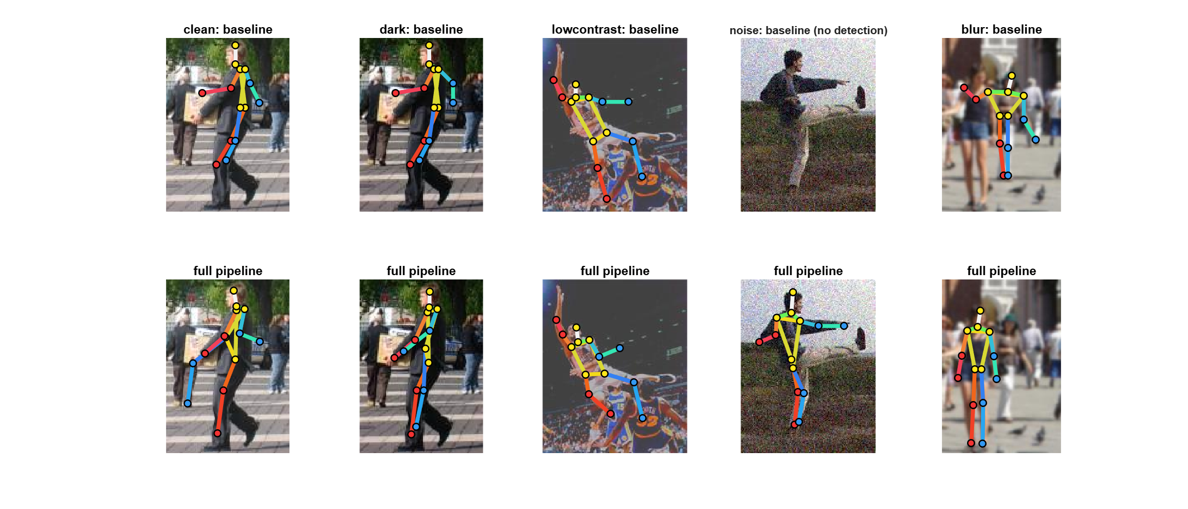
Pose estimation: input and output
02 / DEMO
MEASURED OUTPUT
TOP ROW
Baseline FMP on the degraded image.
BOTTOM ROW
Full enhanced pipeline, same image.
NOTE
Largest gain per condition, chosen for illustration. The tables later are not cherry-picked.
CLASSICAL HUMAN POSE ESTIMATION / FINAL REVIEW
3
Notes:
Unlike the mid-review demo, these are real outputs of our system on held-out PARSE test images. Each column is one condition; the top row is baseline FMP, the bottom row is the full pipeline. Under noise, baseline FMP does not find the person at all, and the enhanced pipeline recovers the full skeleton. These are the best example per condition, picked to show what the stages do; the quantitative results later cover every image.

Slide 4
One image. A sequence of transformations.
03 / PIPELINE
01
02
03 · NEW
04
05 · NEW
06 · NEW
07 · NEW
INPUT
ANALYZE
RESTORE
HOG
FMP ×2
VOTE
REFINE
Image pixels
Noise, blur, light
One gated fix
Original features
Image + mirror
NMS + pose voting
Anatomy check
BASELINE
Image → HOG → Pretrained FMP → NMS → Pose
ENHANCED
Image → Quality analysis → Gated restoration → HOG → Pretrained FMP (image + mirror) → NMS + pose voting → Anatomical refinement → Pose
The FMP model and HOG features are shared by both rows, so the comparison is fair. Novelty: an adaptive layer around classical FMP, not a replacement for it.
CLASSICAL HUMAN POSE ESTIMATION / FINAL REVIEW
4
Notes:
Seven stages. The blue ones are new since mid-review. Stage 2 measures the image, stage 3 applies at most one restoration, stage 5 runs the same FMP model on the image and its mirror, stage 6 averages near-duplicate poses instead of trusting a single winner, and stage 7 checks bone lengths. HOG and the pretrained FMP model are identical in both rows, which is what makes the comparison fair.

Slide 5
Adaptive preprocessing: only when needed
04 / IMAGE QUALITY
THE IMAGE IS MEASURED FIRST
Condition | Signal | Action | Status
Noise | σ > 6 | Non-local-means denoising | Implemented
Blur | sharpness < 0.014 | Richardson-Lucy deblurring | Implemented
Dark | brightness < 0.40 | Gamma correction (0.67) | Implemented
Low contrast | — | None: HOG already normalises contrast | By design
Otherwise | — | Image left unchanged | —
BRIGHTNESS
Mean luminance
CONTRAST
1st–99th percentile range
NOISE
Immerkær σ: a mask that cancels image structure
SHARPNESS
At most one operation per image, priority noise → blur → dark. Tested and rejected on the tuning images: CLAHE, bilateral, median, Wiener and Gaussian denoising, unsharp masking, contrast stretching, upsampling.
Laplacian energy ÷ luminance variance
CLASSICAL HUMAN POSE ESTIMATION / FINAL REVIEW
5
Notes:
At mid-review, noise and blur were detected but not corrected. Now every row is implemented. Two measurement changes mattered as much as the filters: the Immerkær noise estimator separates clean from noisy images cleanly, and the sharpness measure is divided by contrast so low-contrast images are not mistaken for blurred ones. Each image gets at most one fix. Every operator here won a measured comparison on PARSE test images 1 to 100; the rejected list lost.

Slide 6
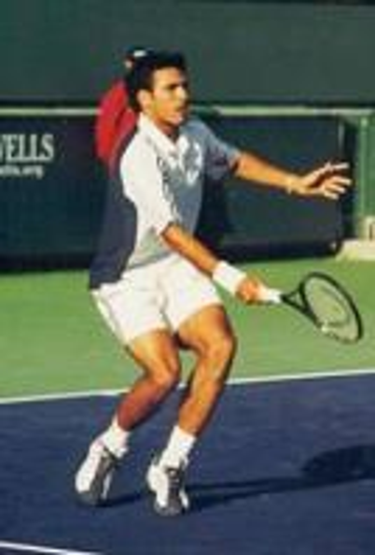
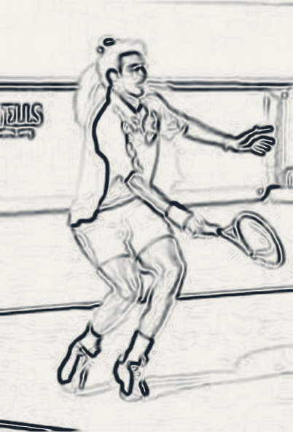
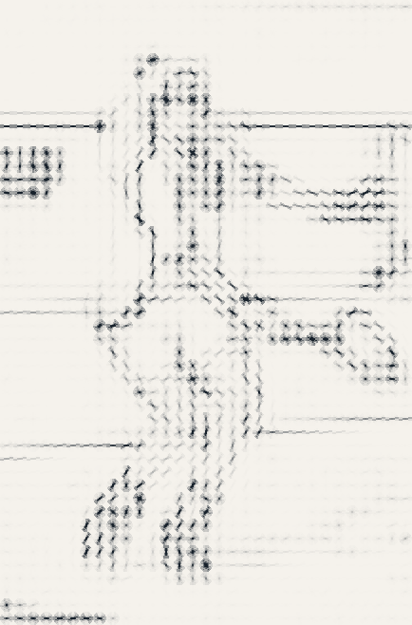
HOG turns edges into a visual description
05 / FEATURES
WHAT HOG MEASURES
Edge directions per 4 × 4-pixel cell, normalised per block, so global contrast changes cancel out.
WHY RESTORATION MATTERS
Noise adds random gradients and blur flattens real ones. Both scramble what FMP matches.
ADAPTIVE HOG: TESTED
INPUT
GRADIENTS
HOG
Weighted HOG: ±0.1 PCK. Denser scale pyramid: +0.1 PCK, −0.4 APK. Changing cells or bins needs retraining.
CLASSICAL HUMAN POSE ESTIMATION / FINAL REVIEW
6
Notes:
All three images are computed from a real PARSE test photo with our own code: the gradient magnitude, and the HOG orientations from FMP’s feature extractor. In the HOG view each cell is shaded by its edge strength so the player stands out; FMP itself sees the normalised version. Because each block is normalised, a global contrast change cancels out, which is why low-contrast fixes did nothing. Noise and blur change the gradient directions themselves, so they must be fixed before HOG. Adaptive HOG was implemented and tested, but it does not change accuracy without retraining the FMP filters, which needs the full INRIA negative set.

Slide 7
FMP links parts into a body layout
06 / POSE MODEL
FLEXIBLE MIXTURES OF PARTS (FMP)
1
PART APPEARANCE
Does this region look like a head, arm or leg?
2
SPATIAL LINKS
Do connected parts form a plausible layout?
3
POSE SCORE
Dynamic programming combines both over the 26-part tree.
4
FLIP TTA (NEW)
The same model also runs on the mirrored image; its parts are mapped back with left and right swapped.
HOG says what a part looks like. FMP says how the parts fit together. Base paper: Yang & Ramanan, CVPR 2011.
CLASSICAL HUMAN POSE ESTIMATION / FINAL REVIEW
7
Notes:
FMP is a classical part-based method, not a CNN. It scores how much each region looks like a part, how plausible the connections are, and combines both with dynamic programming over a 26-part tree. We never change this model. What we add is test-time augmentation: we run the same model on the mirror image too, map the detections back, and swap left and right parts. That gives the model two independent looks at every image.

Slide 8
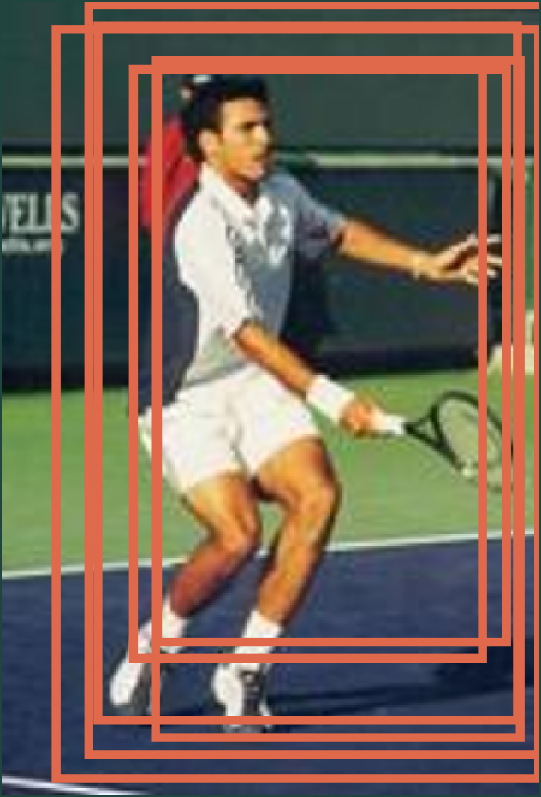
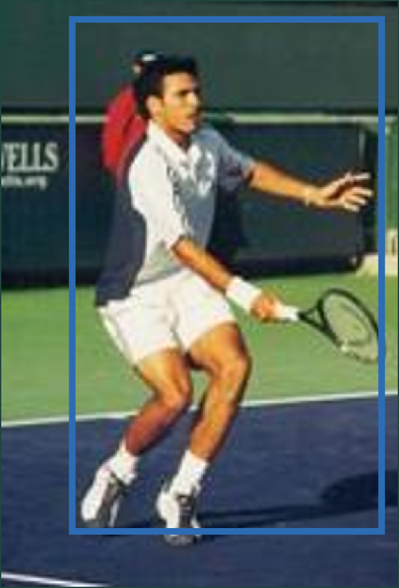
NMS cleans up overlapping detections
07 / DETECTION
WHAT NMS DOES
Keeps the best detection and removes overlapping duplicates. On its own it does not improve joint coordinates.
NEW: PART-CONSISTENT VOTING
Each joint becomes the score-weighted mean of near-duplicates, but only those that agree on that joint (within 0.25 × body size).
INPUT
CANDIDATES
KEPT
image_quality › adaptive_preprocess › detect_tta › nms › pose_vote › refine_pose
CLASSICAL HUMAN POSE ESTIMATION / FINAL REVIEW
8
Notes:
These boxes are real FMP candidates for this PARSE test image, from our evaluation cache. FMP returns many overlapping candidates; NMS keeps the best one and throws the rest away. But those near-duplicates are useful: they are slightly shifted, near-equally good versions of the same pose. Pose voting averages them, weighted by score, which smooths out the jitter of the HOG cell grid. Our first version averaged whole poses and pulled heads off target. The final version is part-consistent: a candidate only votes for a joint if it agrees with the chosen pose on where that joint is, so two different arm or head hypotheses are never blended. With flip TTA, the mirrored detections vote too. The bottom line is the actual MATLAB call chain.

Slide 9
How we evaluate: paired comparison
08 / EVALUATION
Setting | Fair-comparison rule
Datasets | PARSE: 205 test images · BUFFY: 276 test frames
Same model | The same pretrained FMP detector in every row
Conditions | Clean, dark, low contrast, noise, blur (same images)
Tuning split | PARSE test images 1–100: every choice made here
Report split | PARSE test images 101–205: never used for tuning
Statistics | Paired bootstrap 95% confidence interval
PCK
Share of joints within 0.1 × body size of the ground truth.
APK
Average precision of keypoints across all detections.
RUNTIME · MEASURED
Every number in this deck comes from run_final_evaluation(101:205) and reproduces exactly. FMP is deterministic.
About 1.3 s → 2.4 s per image on a CPU.
CLASSICAL HUMAN POSE ESTIMATION / FINAL REVIEW
9
Notes:
The most important change since mid-review is the protocol. We split the PARSE test set: images 1 to 100 were used to choose every operator, threshold and parameter; images 101 to 205 were never looked at during tuning and give the numbers we report. BUFFY was never tuned on at all, so it is a true cross-dataset check. Changes come with paired bootstrap confidence intervals, so we can say which gains are real and which are noise. One disclosure: our last improvement, part-consistent voting, was prompted by per-joint losses in a first held-out report; we designed and tuned it on images 1 to 100 only and scored the held-out images once.

Slide 10
Clean set: no improvement yet
09 / CLEAN-SET RESULTS
HELD-OUT PARSE 101–205 · SAME FMP DETECTOR AND ANNOTATIONS
CHANGE IN PCK
Metric | Baseline FMP | Full pipeline | Change
Mean PCK | 75.37% | 76.53% | +1.16 pp
Mean APK | 66.19% | 68.07% | +1.88 pp
+1.16
Positive, not yet significant: 95% CI −1.53 to +3.61
WHAT THE RESULT SAYS
HOW WE REPORT IT
Both metrics rise on clean images, but 105 images cannot yet prove it.
No significant clean gain is claimed. The pipeline targets degraded images.
CLASSICAL HUMAN POSE ESTIMATION / FINAL REVIEW
10
Notes:
At mid-review the clean set went slightly down. Now, on the held-out clean images, the full pipeline is 1.2 PCK points and 1.9 APK points above the baseline. The confidence interval still crosses zero, so we do not claim a significant clean improvement; that is why the title still says “no improvement yet”. What matters is that the pipeline, built for degraded images, now never costs anything on good ones.

Slide 11
The effect varies across body joints
10 / JOINT RESULTS
PARSE CLEAN · HELD-OUT · PCK %
BUFFY · 276 FRAMES · PCK %
Joint | Baseline | Full | Δ
Head | 91.9 | 90.5 | −1.4
Shoulder | 88.6 | 87.1 | −1.5
Elbow | 68.6 | 70.5 | +1.9
Wrist | 51.4 | 47.6 | −3.8
Hip | 80.0 | 83.3 | +3.3
Knee | 77.6 | 81.4 | +3.8
Ankle | 69.5 | 75.2 | +5.7
Mean | 75.4 | 76.5 | +1.2
Joint | Baseline | Enhanced | Δ
Head | 96.0 | 95.7 | −0.4
Shoulder | 97.1 | 97.1 | 0.0
Elbow | 87.5 | 90.6 | +3.1
Wrist | 67.2 | 68.8 | +1.6
Hip | 85.3 | 89.5 | +4.2
Mean | 86.6 | 88.3 | +1.7
No joint is significantly worse: every dip’s 95% CI includes zero. The ankle gain (+5.7) is significant; both means rise.
CLASSICAL HUMAN POSE ESTIMATION / FINAL REVIEW
11
Notes:
Per joint, legs and elbows gain the most: on clean held-out PARSE images, ankles gain 5.7 points, knees 3.8, hips 3.3. Wrists, heads and shoulders dip slightly. We checked each joint with a paired bootstrap: every dip has a 95% confidence interval that includes zero. The wrist, for example, is 18 joints worse and 10 better out of 210, with an interval from minus 9.5 to plus 1.9; on the tuning images wrists went up. The ankle gain is the only per-joint change that is significant, from plus 1.4 to plus 10.5. We deliberately did not tune further on these images, because that would be fitting the test set. On BUFFY, which we never tuned on, elbows and hips improve most and the mean rises 1.7 points. Blue means a gain, coral a loss; the sign is also written in every cell.

Slide 12
The policy is deliberately conservative
11 / PREPROCESSING ACTIVITY
SHARE OF IMAGES RESTORED · HELD-OUT PARSE · 105 PER CONDITION
ONE FIX AT MOST
Clean
31%
Noise first, then blur, then darkness. Low-contrast images are left alone by design.
Dark
69%
Low contrast
15%
MID-REVIEW → NOW
Noise
100%
Noise and blur were detected only. Now every noisy image and 89% of blurred ones are restored.
Blur
89%
The 31% of clean photos that trigger a fix are dim, soft or grainy originals. Clean PCK is still unchanged overall.
CLASSICAL HUMAN POSE ESTIMATION / FINAL REVIEW
12
Notes:
The gate fires where it should: on every noisy image, on 89% of blurred ones and on most dark ones, and rarely on low-contrast images, which we deliberately leave alone. Each image receives at most one operation. About a third of clean PARSE photos are dim or slightly soft and trigger a fix, but the clean result on slide 10 shows this costs nothing. At mid-review, noise and blur were detected but never corrected.

Slide 13
Modest gains: dark and low contrast
12 / ROBUSTNESS
NOISE · SIGNIFICANT
BLUR · SIGNIFICANT
DARK · SIGNIFICANT
LOW CONTRAST · MODEST
+6.0
+6.8
+2.9
+2.0
PCK · APK +8.1
PCK · APK +10.7
PCK · APK +2.2
PCK · APK +3.6
Condition | Base PCK | Full PCK | Δ PCK [95% CI] | Base APK | Full APK | Δ APK
Dark | 75.51 | 78.37 | +2.86 [+0.54, +5.03] | 67.13 | 69.30 | +2.17
Low contrast | 74.76 | 76.80 | +2.04 [−0.48, +4.22] | 66.28 | 69.85 | +3.57
Noise | 68.78 | 74.76 | +5.99 [+2.69, +9.12] | 57.26 | 65.38 | +8.12
Blur | 68.91 | 75.71 | +6.80 [+3.95, +10.07] | 57.43 | 68.14 | +10.71
Dark and low contrast gain modestly, dark now significantly. Noise and blur gain the most, almost fully closing the gap to clean images.
CLASSICAL HUMAN POSE ESTIMATION / FINAL REVIEW
13
Notes:
At mid-review, this slide showed small gains on dark and low-contrast images and nothing on noise and blur. Dark and low contrast are still the smaller gains, plus 2.9 and plus 2.0 PCK, and the dark gain is now statistically significant. The big change is noise and blur: plus 6.0 PCK and 8.1 APK under noise, plus 6.8 PCK and 10.7 APK under blur, both with confidence intervals well above zero. Clean baseline is 75.4 PCK, so noisy images go from 68.8 to 74.8 and blurred from 68.9 to 75.7: nearly back to clean quality.

Slide 14
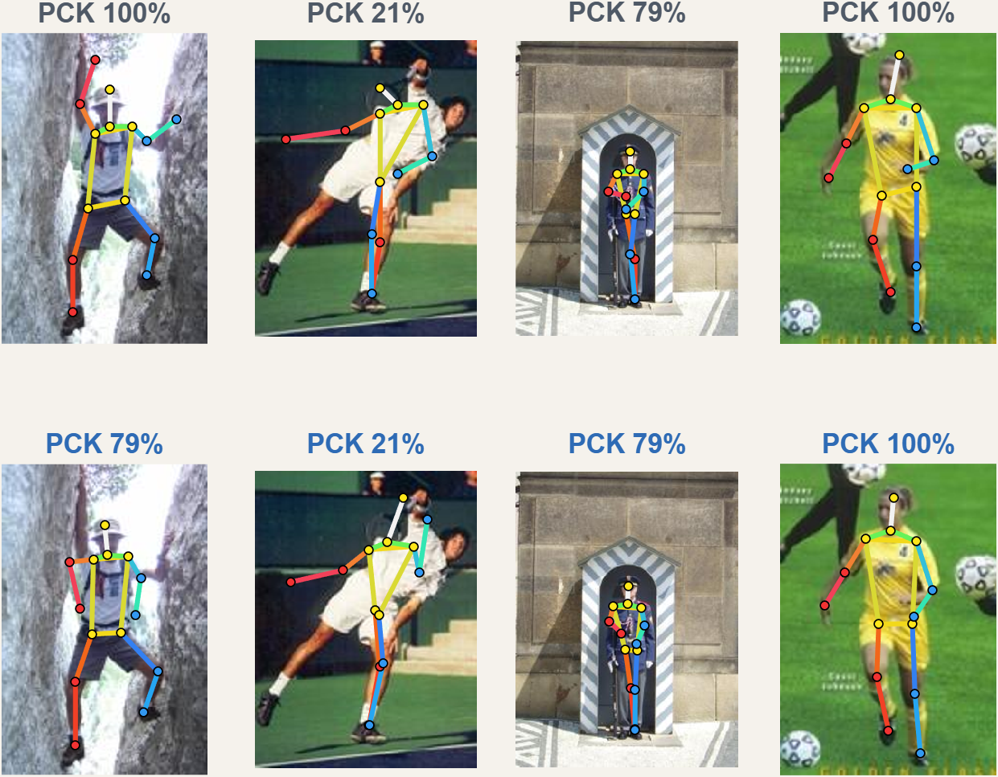
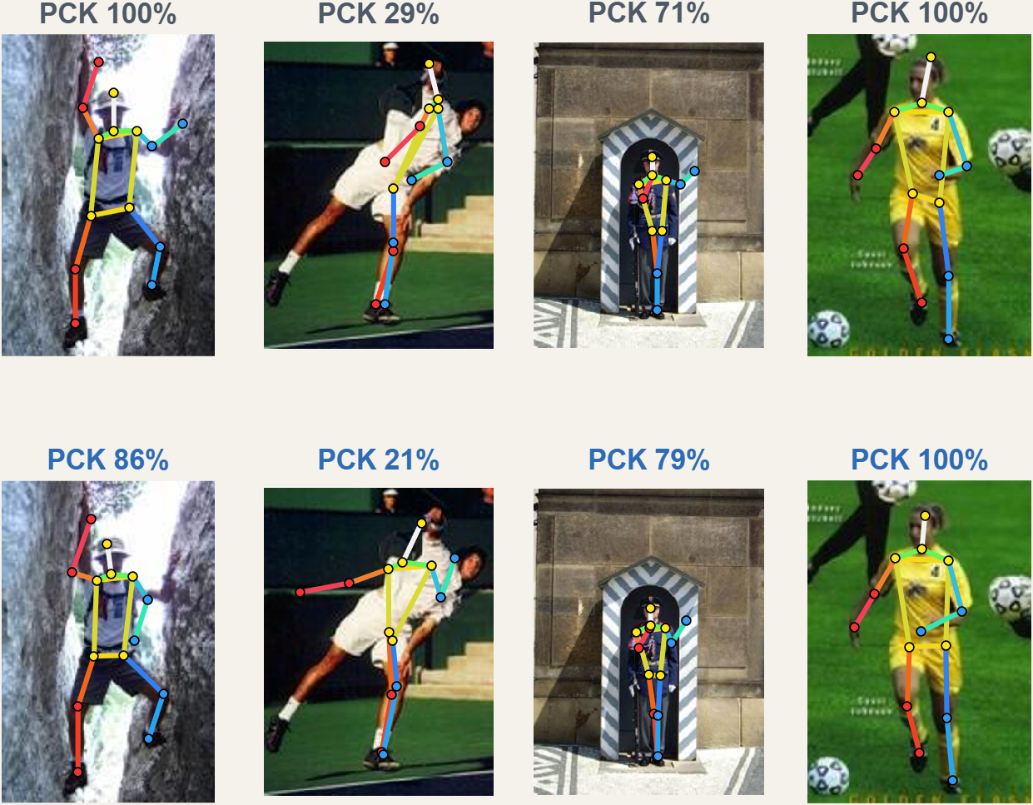
Model outputs: clean and dark images
13 / MODEL OUTPUTS · 1 OF 3
CLEAN
top: baseline · bottom: enhanced
DARK
top: baseline · bottom: enhanced
CLASSICAL HUMAN POSE ESTIMATION / FINAL REVIEW
14
Notes:
These are real outputs of both systems on four held-out PARSE test images, numbers 109, 146, 174 and 182, picked at random with a fixed seed, not chosen by how well we did. The same four images appear on the next two slides under the other conditions. Above each pose is that image’s PCK. On individual images the enhanced pipeline sometimes wins and sometimes loses; the second image is hard for both. The averages over all 105 held-out images, on the previous slides, are what we claim.

Slide 15
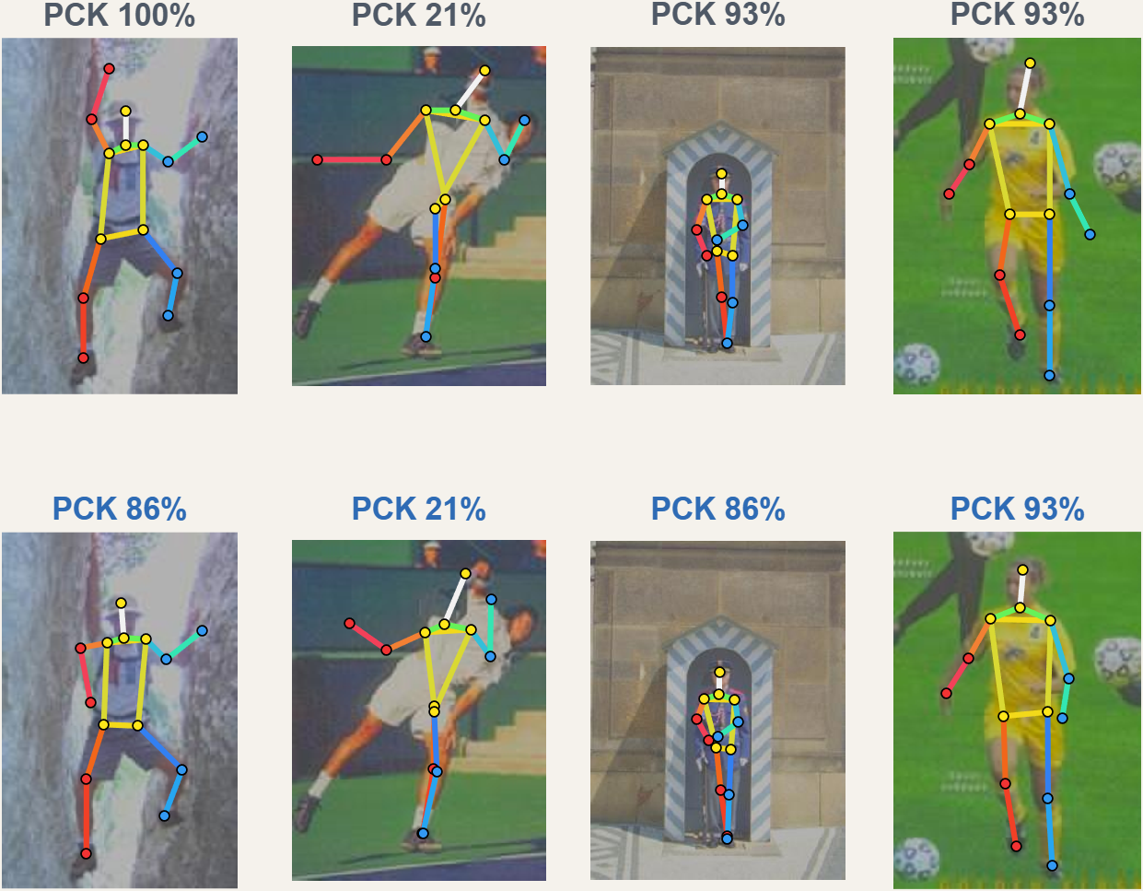
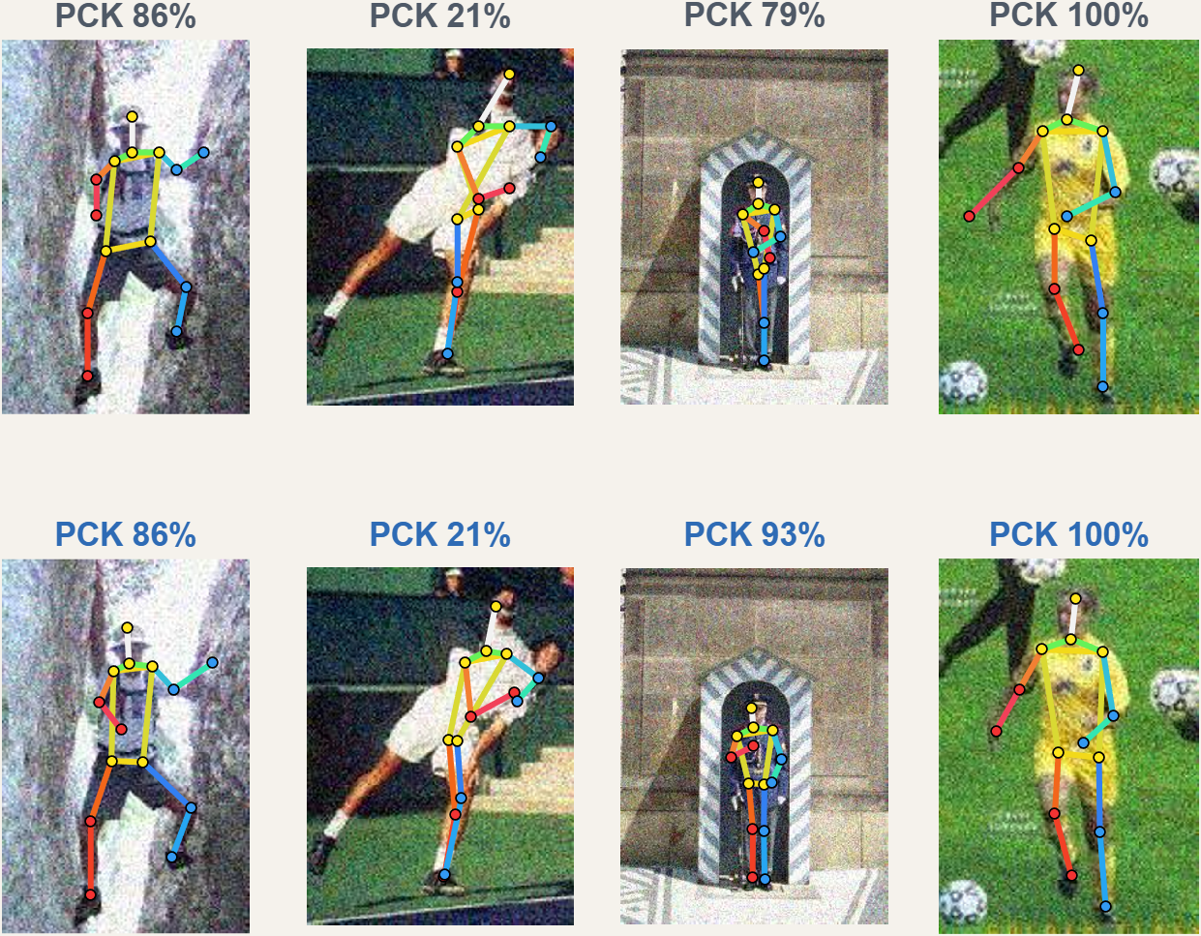
Model outputs: low-contrast and noisy images
13 / MODEL OUTPUTS · 2 OF 3
LOW CONTRAST
top: baseline · bottom: enhanced
NOISE
top: baseline · bottom: enhanced
CLASSICAL HUMAN POSE ESTIMATION / FINAL REVIEW
15
Notes:
The same four random images, now under low contrast and under Gaussian noise. Look at the third image under noise: the guard in the booth. Baseline FMP gets 79 percent of his joints; after non-local-means denoising, flip test-time augmentation and voting, the enhanced pipeline gets 93 percent, with the legs now on the body. Under low contrast the two systems are close, which matches the small average gain for that condition.

Slide 16
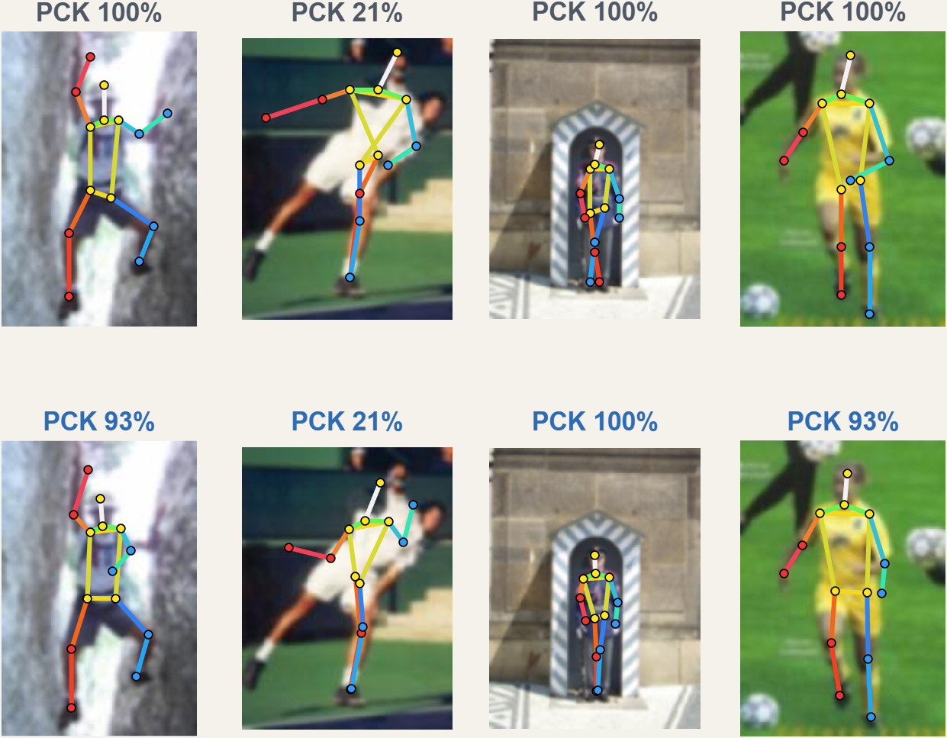
Model outputs: blurred images
13 / MODEL OUTPUTS · 3 OF 3
BLUR
top: baseline · bottom: enhanced
HOW THESE WERE CHOSEN
Four held-out images (109, 146, 174, 182), drawn at random with a fixed seed. Not picked by result.
WHAT THEY SHOW
Single images go up or down by a joint or two. Gains only show up reliably as averages over many images.
WHAT WE CLAIM
Over all 105 held-out images: blur +6.8, noise +6.0, dark +2.9 PCK.
CLASSICAL HUMAN POSE ESTIMATION / FINAL REVIEW
16
Notes:
The last condition, blur, on the same four random images. On these four, the enhanced pipeline loses a joint on two images and ties on the others; that is what random examples look like. We show them on purpose: slide 3 showed the best example per condition, and these show typical ones. Our claim rests on the averages over all 105 held-out images, with confidence intervals, not on any single picture.

Slide 17
What we learned
14 / TAKEAWAYS
1
2
3
4
CLEAN IMAGES
DARK & LOW CONTRAST
NOISE & BLUR
ONE RULE IS NOT ENOUGH
Do no harm. The full pipeline adds +1.2 PCK and +1.9 APK on clean images.
HOG already normalises contrast. Gamma plus voting gives +2.9 PCK on dark images.
The right operator matters: non-local means and deconvolution lead to +6.0 and +6.8 PCK.
Measure each image, apply one fix, and test on images you never tuned on.
CLASSICAL HUMAN POSE ESTIMATION / FINAL REVIEW
17
Notes:
Four lessons. Clean images must not be harmed, and the final pipeline even adds a little there. Dark and low-contrast images gain less because HOG already normalises contrast. Noise and blur need the right operator: our first bilateral filter and sharpening did nothing, while non-local means and Richardson-Lucy deconvolution, combined with flip TTA and part-consistent voting, recover 6 to 7 PCK points. And one generic rule is not enough: measure each image, apply one fix, and always test on images you did not tune on.

Slide 18
Completed work and next steps
15 / ROADMAP
Phase | Plan | Status | Result
Mid-review | Quality analysis, gamma and contrast, first evaluation | Completed | Flat results
1 | Noise handling: non-local-means denoising | Completed | +6.0 PCK on noise
2 | Blur handling: Richardson-Lucy deconvolution | Completed | +6.8 PCK on blur
3 | Ablation: baseline → adaptive HOG → preprocess → flip + vote → refine | Completed | Per-stage table
4 | Adaptive HOG (needs FMP retraining) | Investigated | No change (±0.1)
5 | Pose refinement and part-consistent voting for weak joints | Completed | Clean +1.2 PCK
6 | Final evaluation: 5 conditions, APK, PCK, joints, runtime, BUFFY | Completed | BUFFY +1.7 PCK
Next | Retrain FMP with adaptive HOG; real-world blur with estimated PSF | Future work | —
CLASSICAL HUMAN POSE ESTIMATION / FINAL REVIEW
18
Notes:
This is the mid-review roadmap with today’s status. Every phase is done except adaptive HOG, which we implemented and tested but which needs the FMP model retrained on the new features; that needs the full INRIA negative set, which is not in our repository. The next steps are that retraining and handling real-world blur, where the blur kernel must be estimated rather than assumed.

Slide 19
What the abstract promised
16 / ABSTRACT CHECK
Abstract item | What we did and measured | Status
Image-quality analysis | Brightness, contrast, Immerkær noise σ, sharpness | Delivered
CLAHE | −0.5 PCK on every image; +0.1 on low contrast only | Tested, not adopted
Gamma correction | Gamma 0.67 on dark images | Delivered
Denoising | Non-local means (+3.3) beat the bilateral filter (+1.7) | Delivered
Detail enhancement | Richardson-Lucy deblurring beat sharpening | Delivered
Adaptive HOG | Weighted HOG ±0.1, denser pyramid +0.1; bins need retraining | Investigated
Original FMP unchanged | Same pretrained model and inference throughout | Delivered
Pose refinement | Bone bounds, symmetry, part-consistent voting | Delivered
PARSE, BUFFY, PCK, APK | Both metrics up in every condition, on both datasets | Delivered
Low computational cost | About 1.3 s → 2.4 s per image, CPU only | Delivered
CLASSICAL HUMAN POSE ESTIMATION / FINAL REVIEW
19
Notes:
This slide checks every promise in our abstract. Eight items are delivered. Two were tested and honestly not adopted. CLAHE lowers accuracy when applied to every image, because its tiles add local edges that HOG reads as structure, and on low-contrast images alone it gains only 0.1, below the 0.3 bar we set before testing. Adaptive HOG: the gradient-weighted version changes nothing, a denser scale pyramid gains 0.1 PCK but loses 0.4 APK and doubles the time, and changing cell size or orientation bins changes the feature dimensions the FMP filters were trained on, so it needs retraining. All of these decisions were measured on PARSE test images 1 to 100.

Slide 20

Conclusion
17 / CONCLUSION
Adaptive preprocessing was the experiment. Held-out evaluation says it works where images are degraded.
Classical FMP retained: model and inference unchanged
Quality analysis and gated restoration implemented
Noise +6.0, blur +6.8, dark +2.9 PCK, intervals above zero
Every condition positive, clean +1.2; BUFFY +1.7 PCK untuned
About 1.3 s → 2.4 s per image on a CPU, no GPU
CLASSICAL FMP, ENHANCED INPUT
CLASSICAL HUMAN POSE ESTIMATION / FINAL REVIEW
20
Notes:
At mid-review we said adaptive preprocessing is the experiment and paired evaluation decides whether it helps. It now has a clear answer. On held-out images it improves FMP in every condition: by 6 to 7 PCK points under noise and blur and 2.9 on dark images, all with confidence intervals above zero, and slightly on clean images too. It carries over to BUFFY without any tuning there. The FMP model itself was never changed. Thank you; we are happy to take questions.

